Slide 1
Module 3 - Searching and Sorting

Slide 2

Searching: Linear Search
Suppose, you are given a jar containing some business cards.
You are asked to determine whether the name “Bill Gates" is in the jar.
To do this, you decide to simply go through all the cards one by one.
How long this takes?
Can be determined by how many cards are in the jar, i.e., Size of Input.
Linear search is a method for finding a particular value from the given list.
The algorithm checks each element, one at a time and in sequence, until the desired element is found.
Linear search is the simplest search algorithm.

Slide 3



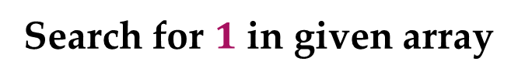






Linear Search – Example
Search for $1$ in given array
$$2$$ | $$9$$ | $$3$$ | $$1$$ | $$8$$
Comparing value of i^{th} index with the given element one by one, until we get the required element or end of the array
Step 1: i=1
Step 3: i=3
$$2$$ | $$9$$ | $$3$$ | $$1$$ | $$8$$
$$2$$ | $$9$$ | $$3$$ | $$1$$ | $$8$$
i
i
$$2≠1$$
$$3≠1$$
Step 2: i=2
Step 4: i=4
$$2$$ | $$9$$ | $$3$$ | $$1$$ | $$8$$
$$2$$ | $$9$$ | $$3$$ | $$1$$ | $$8$$
$$1$$
i
i
$$9≠1$$
Element found at i^{th} index, i=4

Slide 4
Linear Search - Algorithm
# Input : Array A, element x
# Output : First index of element x in A or -1 if not found
Algorithm: Linear_Search
for i = 1 to last index of A
if A[i] equals element x
return i
return -1

Slide 5

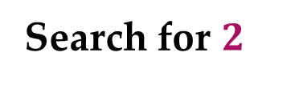


Linear Search - Analysis
The required element in the given array can be found at,
Case 1: element 2 which is at the first position so minimum comparison is required
Case 2: element 3 anywhere after the first position so, an average number of comparison is required
Case 3: element 7 at last position or element does not found at all, maximum comparison is required
Best Case
Average Case
Worst Case
Worst Case
Search for $2$
$$3$$
$$7$$
$$2$$ | $$9$$ | $$3$$ | $$1$$ | $$8$$ | $$7$$
Best Case
Average Case

Slide 6
Analysis of Algorithm
Best Case | Average Case | Worst Case
Resource usage is minimum | Resource usage is average | Resource usage is maximum
Algorithm’s behavior under optimal condition | Algorithm’s behavior under random condition | Algorithm’s behavior under the worst condition
Minimum number of steps or operations | Average number of steps or operations | Maximum number of steps or operations
Lower bound on running time | Average bound on running time | Upper bound on running time
Generally do not occur in real | Average and worst-case performances are the most used in algorithm analysis.

Slide 7
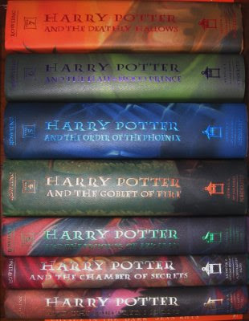
Book Finder Example
Suppose, you are writing a program to find a book from the shelf.
For any required book, it will start checking books one by one from the bottom.
If you wanted Harry Potter 3, it would only take 3 actions (or tries) because it’s the third book in the sequence.
If Harry Potter 7 — it’s the last book so it would have to check all 7 books.
What if there are total 10 books? How about 10,00,000 books? It would take 1 million tries.

Slide 8




Number Sorting - Example
Suppose you are sorting numbers in Ascending / Increasing order.
The initial arrangement of given numbers can be in any of the following three orders.
Case 1: Numbers are already in required order, i.e., Ascending order
No change is required
Case 2: Numbers are randomly arranged initially. Some numbers will change their position
Case 3: Numbers are initially arranged in Descending order so, all numbers will change their position
Best Case
Average Case
Worst Case
$$5$$ | $$9$$ | $$12$$ | $$23$$ | $$32$$ | $$41$$
$$9$$ | $$5$$ | $$12$$ | $$32$$ | $$23$$ | $$41$$
$$5$$ | $$9$$ | $$12$$ | $$23$$ | $$32$$ | $$41$$
$$41$$ | $$32$$ | $$23$$ | $$12$$ | $$9$$ | $$5$$

Slide 9
Best, Average, & Worst Case
Problem | Best Case | Average Case | Worst Case
Linear Search | Element at the first position | Element in any of the middle positions | Element at last position or not present
Book Finder | The first book | Any book in-between | The last book
Sorting | Already sorted | Randomly arranged | Sorted in reverse order

Slide 10
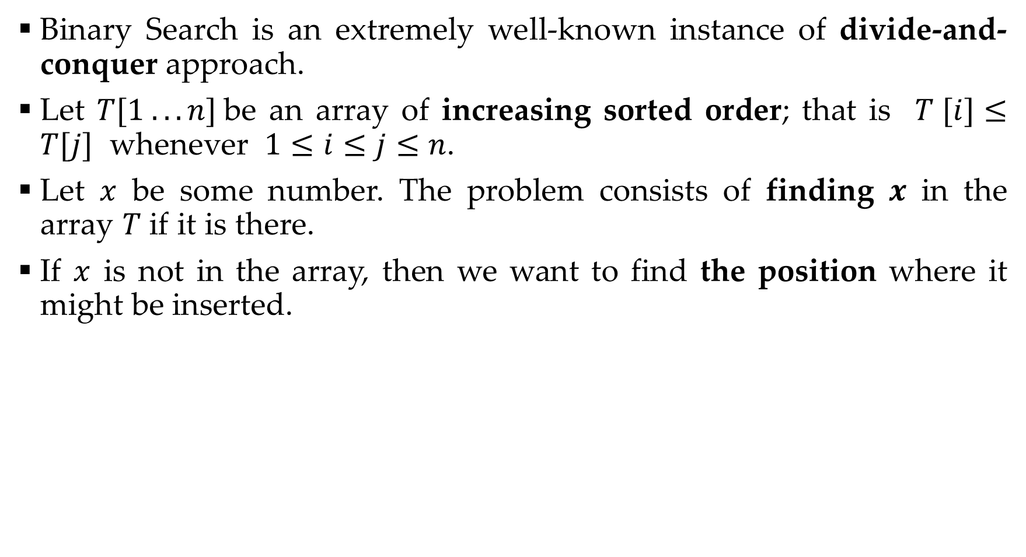
Binary search
Binary Search is an extremely well-known instance of divide-and-conquer approach.
Let $T[1 . . . n]$be an array of increasing sorted order; that is $T [i]≤T[j]$ whenever $1≤i≤j≤n$.
Let $x$ be some number. The problem consists of finding $x$ in the array $T$ if it is there.
If $x$ is not in the array, then we want to find the position where it might be inserted.

Slide 11
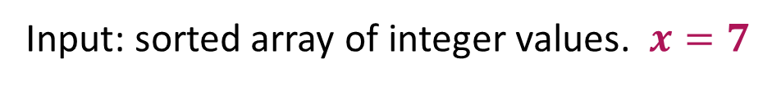
Binary Search Example
Input: sorted array of integer values. $x=7$
1 | 3 | 7 | 9 | 11 | 32 | 52 | 74 | 90
Step 1:
1 | 2 | 3 | 4 | 5 | 6 | 7 | 8 | 9
1 | 3 | 7 | 9 | 11 | 32 | 52 | 74 | 90
Find approximate midpoint

Slide 12



Binary Search Example
Step 2:
$$x=7$$
1 | 2 | 3 | 4 | 5 | 6 | 7 | 8 | 9
1 | 3 | 7 | 9 | 11 | 32 | 52 | 74 | 90
Is $7$ < midpoint value? YES.
Is $7$ = midpoint value? No.
Step 3:
1 | 2 | 3 | 4 | 5 | 6 | 7 | 8 | 9
1 | 3 | 7 | 9 | 11 | 32 | 52 | 74 | 90
Search for the target in the area before midpoint.

Slide 13

Binary Search Example
Step 4:
$$x=7$$
1 | 2 | 3 | 4 | 5 | 6 | 7 | 8 | 9
1 | 3 | 7 | 9 | 11 | 32 | 52 | 74 | 90
Find approximate midpoint
Step 5:
1 | 2 | 3 | 4 | 5 | 6 | 7 | 8 | 9
1 | 3 | 7 | 9 | 11 | 32 | 52 | 74 | 90
$7$ > value of midpoint? YES.

Slide 14

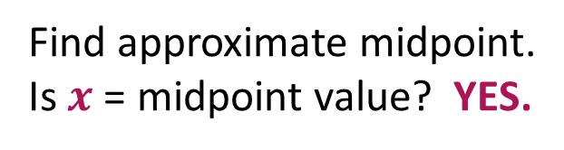
Binary Search Example
Step 6:
$$x=7$$
1 | 2 | 3 | 4 | 5 | 6 | 7 | 8 | 9
1 | 3 | 7 | 9 | 11 | 32 | 52 | 74 | 90
Search for the $x$ in the area after midpoint.
Step 7:
1 | 2 | 3 | 4 | 5 | 6 | 7 | 8 | 9
1 | 3 | 7 | 9 | 11 | 32 | 52 | 74 | 90
Find approximate midpoint.
Is $x$ = midpoint value? YES.

Slide 15



Binary Search – Iterative Algorithm
Algorithm: Function biniter(T[1,…,n], x)
if x > T[n] then return n+1
i ← 1;
j ← n;
while i < j do
k ← (i + j ) ÷ 2
if x ≤ T [k] then j ← k
else i ← k + 1
return i
$$n=7$$
$$x=33$$
$$x=7$$
i
3
6
7
k
11
32
33
j
53
j

Slide 16
Binary Search – Recursive Algorithm
Algorithm: Function binsearch(T[1,…,n], x)
if n = 0 or x > T[n] then return n + 1
else return binrec(T[1,…,n], x)
Function binrec(T[i,…,j], x)
if i = j then return i
k ← (i + j) ÷ 2
if x ≤ T[k] then
return binrec(T[i,…,k],x)
else return binrec(T[k + 1,…,j], x)

Slide 17
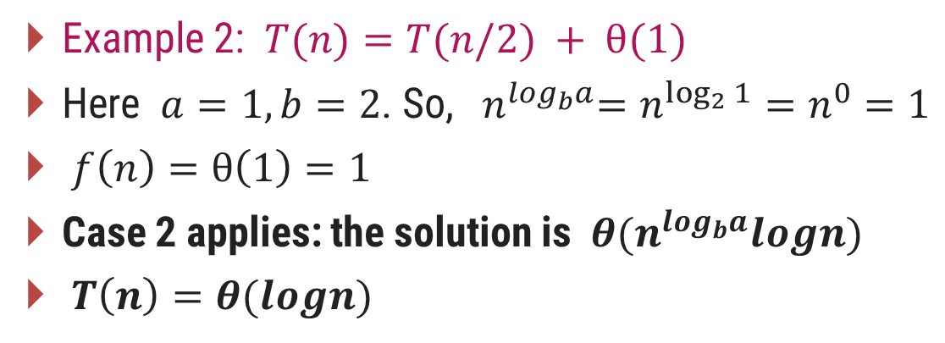

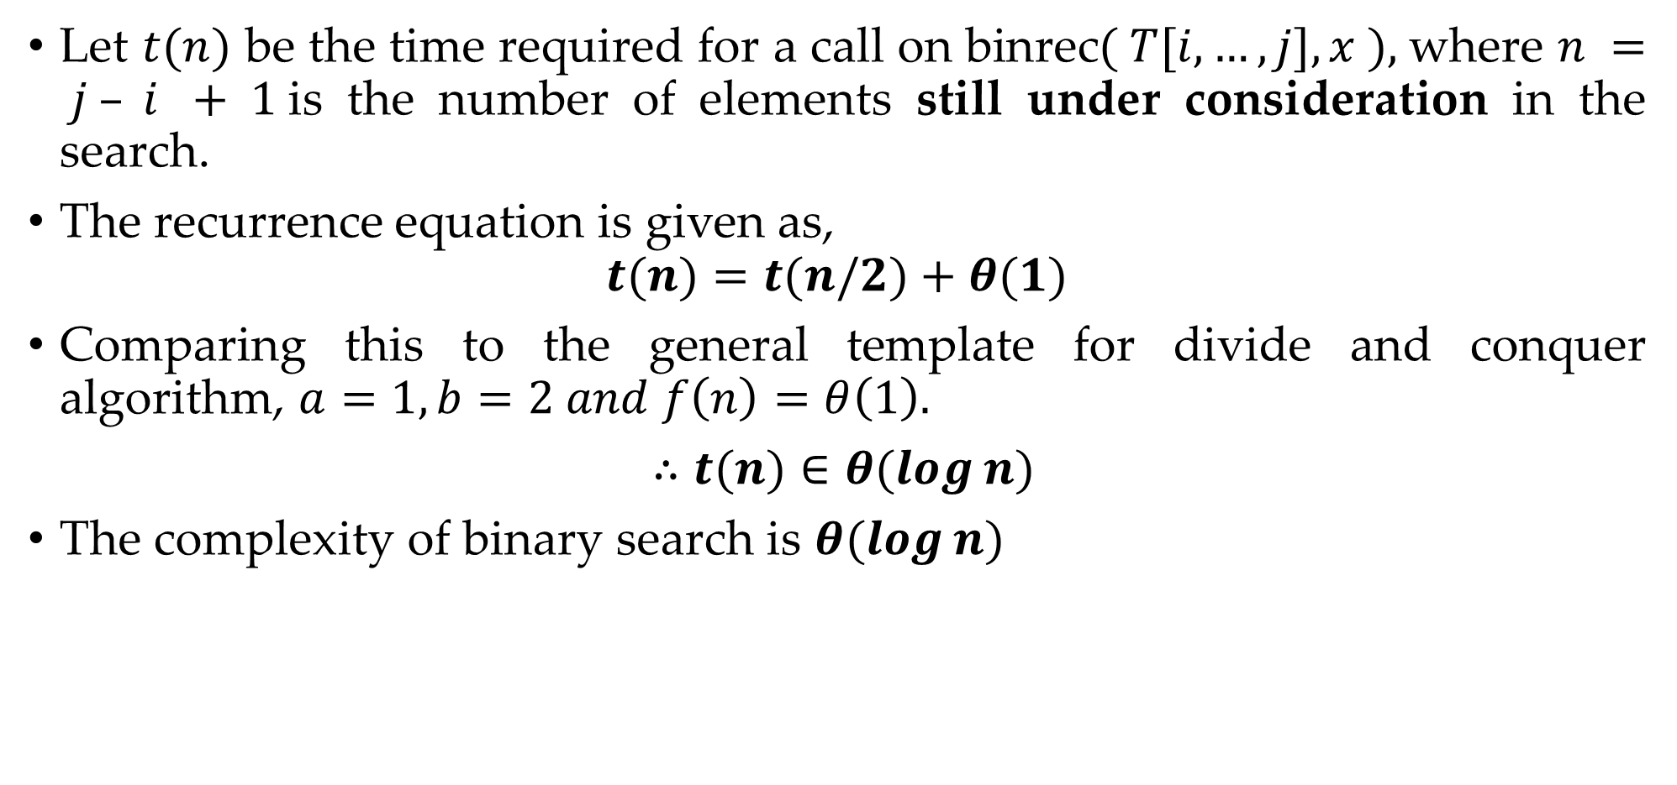
Binary Search - Analysis
Let $t(n)$ be the time required for a call on binrec$( T[i,…,j], x ),$where $n = j – i + 1$is the number of elements still under consideration in the search.
The recurrence equation is given as,
$$t(n)=t(n/2)+θ(1)$$
Comparing this to the general template for divide and conquer algorithm, $a=1, b=2 and f\left(n\right)=θ\left(1\right).$
$∴t(n)∈θ(log⁡n)$
The complexity of binary search is $θ(log⁡n)$
$$T(n)=aT(n/b)+f(n)$$

Slide 18
Analyzing Control Statements

Slide 19
For Loop
# Input : int A[n], array of n integers
# Output : Sum of all numbers in array A
Algorithm: int Sum(int A[], int n)
{
int s=0;
for (int i=0; i<n; i++)
s = s + A[i];
return s;
}
n+1
1
n
Total time taken = n+1+n+2 = 2n+3
Time Complexity f(n) = 2n+3

Slide 20



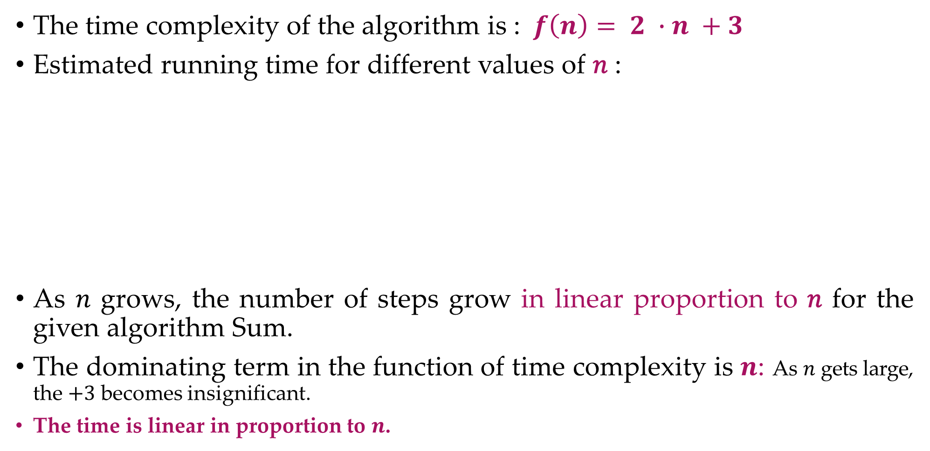





Running Time of Algorithm
The time complexity of the algorithm is : $f\left(n\right)= 2 ∙n +3$
Estimated running time for different values of 𝑛 :
As 𝑛 grows, the number of steps grow in linear proportion to 𝑛 for the given algorithm Sum.
The dominating term in the function of time complexity is $n$: As $n$ gets large, the $+3$ becomes insignificant.
The time is linear in proportion to $n$.
$$n=10$$
$23$ steps
$$n=100$$
$203$ steps
$$n=1000$$
$2,003$ steps
$$n=10000$$
$20,003$ steps

Slide 21
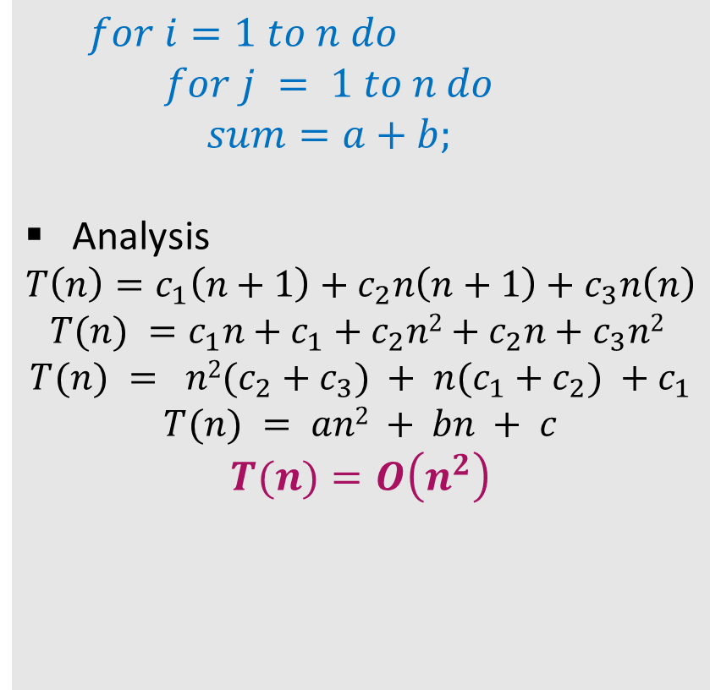

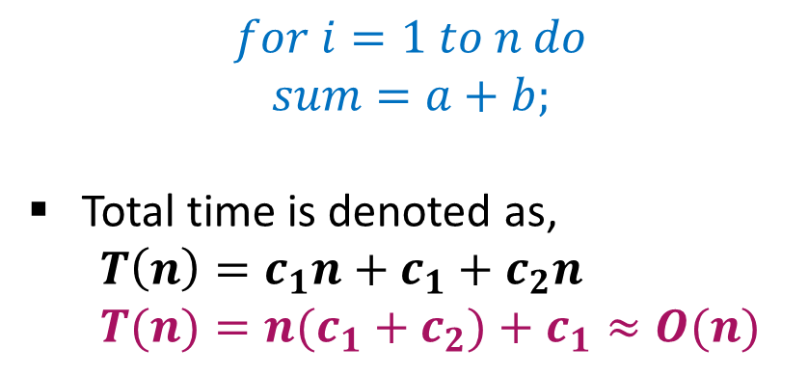

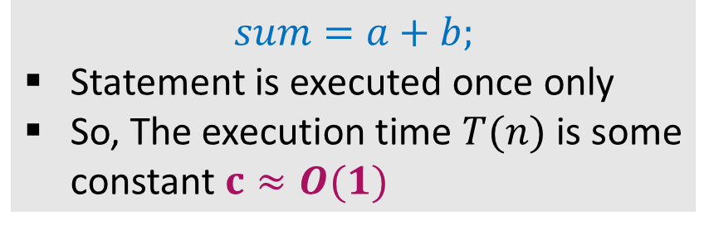






Analyzing Control Statements
Example 1:
Example 3:
$$sum=a+b;$$
Statement is executed once only
So, The execution time $T(n)$ is some constant $c≈O(1)$
$$c_{1} \left(n+1\right)$$
$$c$$
$$for i=1 to n do$$
$$for j = 1 to n do$$
$$sum=a+b;$$
Analysis
$$T\left(n\right)=c_{1}\left(n+1\right)+c_{2}n\left(n+1\right)+c_{3}n\left(n\right)$$
$$T(n) =c_{1}n+c_{1}+c_{2}n2+c_{2}n+c_{3}n2$$
$$T(n) = n2(c_{2}+c_{3}) + n(c_{1}+c_{2}) +c_{1}$$
$$T(n) = an2 + bn + c$$
$$T(n)=O\left(n^{2}\right)$$
$$c_{2} n \left(n+1\right)$$
$$c_{3}∗n∗n$$
Example 2:
$$c_{1}$$
$$for i=1 to n do$$
$$sum=a+b;$$
Total time is denoted as,
$$T\left(n\right)=c_{1}n+c_{1}+c_{2}n$$
$$T(n)=n(c_{1}+c_{2})+c_{1}≈O(n)$$
$$∗\left(n+1\right)$$
$$c_{2}$$
$$∗\left(n\right)$$

Slide 22

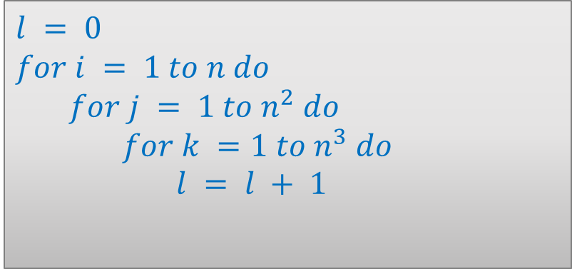

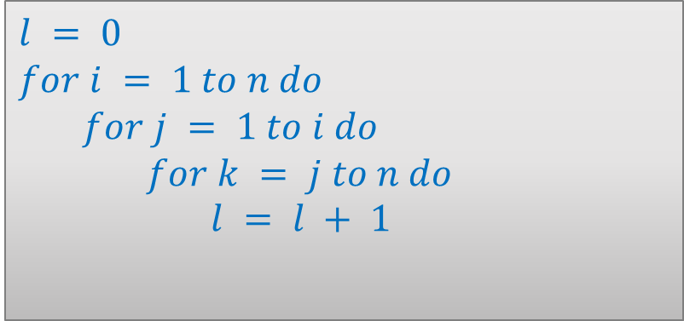

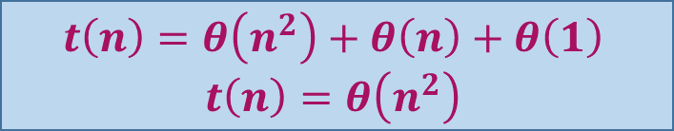



Analyzing Control Statements
Example 4:
Example 6:
$$l = 0$$
$$for i = 1 to n do$$
$$for j = 1 to i do$$
$$for k = j to n do$$
$$l = l + 1$$
$$for j = 1 to n do$$
$$for k = 1 to j do$$
$$sum = sum + j∗k$$
$$for l =1 to n do$$
$$sum=sum− l + 1$$
printf(“sum is now %d”,$sum$)
$$θ\left(n^{2}\right)$$
$$θ\left(n\right)$$
$$t\left(n\right)=θ\left(n^{3}\right)$$
$$θ\left(1\right)$$
Example 5:
$$l = 0$$
$$for i = 1 to n do$$
$$for j = 1 to n^{2} do$$
$$for k =1 to n^{3} do$$
$$l = l + 1$$
$$t\left(n\right)=θ\left(n^{2}\right)+θ\left(n\right)+θ\left(1\right)$$
$$t\left(n\right)=θ\left(n^{2}\right)$$
$$t\left(n\right)=θ\left(n^{6}\right)$$

Slide 23
Sorting Algorithms

Slide 24
Introduction
Sorting is any process of arranging items systematically or arranging items in a sequence ordered by some criterion.
Applications of Sorting
Phone Bill: the calls made are date wise sorted.
Bank statement or Credit card Bill: transactions made are date wise sorted.
Filling forms online: “select country” drop down box will have the name of countries sorted in Alphabetical order.
Online shopping: the items can be sorted price wise, date wise or relevance wise.
Files or folders on your desktop are sorted date wise.

Slide 25
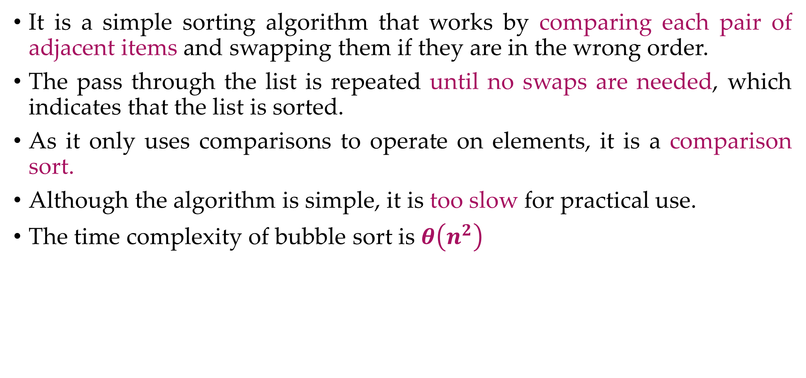
Bubble Sort
It is a simple sorting algorithm that works by comparing each pair of adjacent items and swapping them if they are in the wrong order.
The pass through the list is repeated until no swaps are needed, which indicates that the list is sorted.
As it only uses comparisons to operate on elements, it is a comparison sort.
Although the algorithm is simple, it is too slow for practical use.
The time complexity of bubble sort is $θ\left(n^{2}\right)$

Slide 26
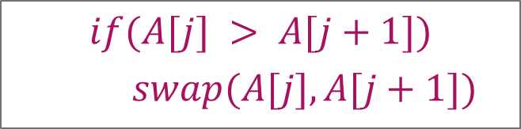
Bubble Sort – Example
Sort the following array in Ascending order
45 | 34 | 56 | 23 | 12
Pass 1 :
45
34
swap
34
34
34
34
45
45
45
45
56
56
56
23
swap
23
23
23
23
56
56
12
swap
12
12
12
12
56
$$if(A[j] > A[j+1])$$
$$swap(A[j],A[j+1])$$

Slide 27
Bubble Sort – Example
Pass 2 :
Pass 3 :
Pass 4 :
34
34
34
34
23
23
23
swap
12
swap
34
45
45
12
23
23
23
34
12
swap
swap
23
12
23
23
34
45
45
12
swap
12
34
12
12
12
45
45
45
45
56
56
56
56
56
56
$$if(A[j] > A[j+1])$$
$$swap(A[j],A[j+1])$$

Slide 28


Bubble Sort - Algorithm
# Input: Array A
# Output: Sorted array A
Algorithm: Bubble_Sort(A)
for i ← 1 to n-1 do
for j ← 1 to n-i do
if A[j] > A[j+1] then
swap(A[j], A[j+1])
$$θ\left(n\right)$$
$$θ\left(n^{2}\right)$$
temp ← A[j]
A[j] ← A[j+1]
A[j+1] ← temp

Slide 29
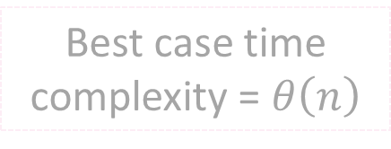
Bubble Sort Algorithm – Best Case Analysis
# Input: Array A
# Output: Sorted array A
Algorithm: Bubble_Sort(A)
int flag=1;
for i ← 1 to n-1 do
for j ← 1 to n-i do
if A[j] > A[j+1] then
flag = 0;
swap(A[j],A[j+1])
if(flag == 1)
cout<<"already sorted"<<endl
break;
Pass 1 :
i = 1
12
j = 1
23
j = 2
34
j = 3
Condition never becomes true
45
j = 4
59
Best case time complexity = $θ\left(n\right)$

Slide 30
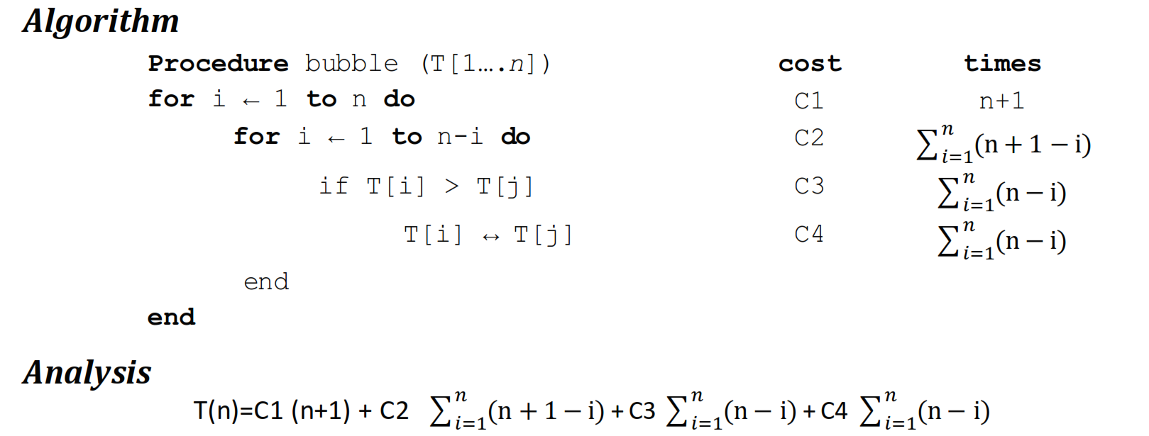
Analysis of Bubble Sort

Slide 31
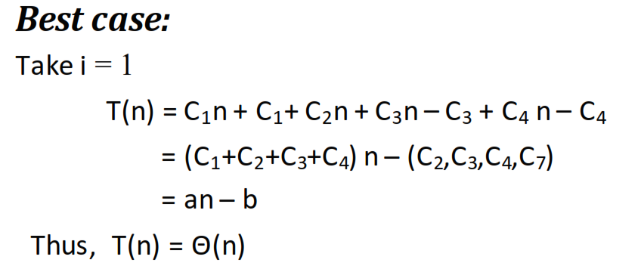
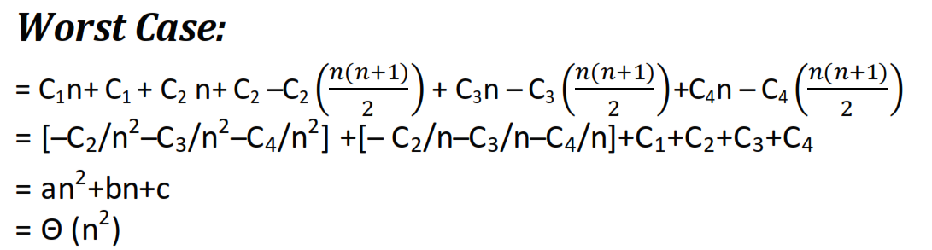
Analysis of Bubble Sort

Slide 32
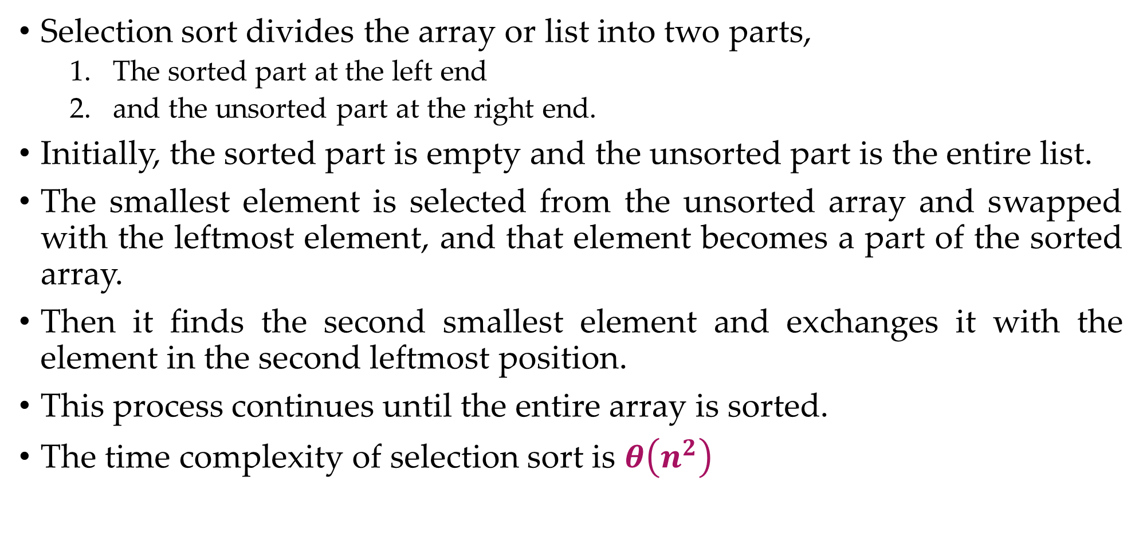
Selection Sort
Selection sort divides the array or list into two parts,
The sorted part at the left end
and the unsorted part at the right end.
Initially, the sorted part is empty and the unsorted part is the entire list.
The smallest element is selected from the unsorted array and swapped with the leftmost element, and that element becomes a part of the sorted array.
Then it finds the second smallest element and exchanges it with the element in the second leftmost position.
This process continues until the entire array is sorted.
The time complexity of selection sort is $θ\left(n^{2}\right)$

Slide 33
Selection Sort – Example 1
Sort the following elements in Ascending order
5 | 1 | 12 | -5 | 16 | 2 | 12 | 14
Step 1 :
Unsorted Array
5 | 1 | 12 | -5 | 16 | 2 | 12 | 14
1 | 2 | 3 | 4 | 5 | 6 | 7 | 8
Step 2 :
Minj denotes the current index and Minx is the value stored at current index.
So, Minj = 1, Minx = 5
Assume that currently Minx is the smallest value.
Now find the smallest value from the remaining entire Unsorted array.
Unsorted Array (elements 2 to 8)
5
-5
1
12
-5
5
16
2
12
14
1
2
3
4
5
6
7
8
Swap
Index = 4, value = -5

Slide 34
Selection Sort – Example 1
Step 3 :
Unsorted Array (elements 3 to 8)
Now Minj = 2, Minx = 1
Find min value from remaining unsorted array
-5
1
1
12
5
16
2
12
14
1
2
3
4
5
6
7
8
Index = 2, value = 1
No Swapping as min value is already at right place
Step 4 :
Unsorted Array
(elements 4 to 8)
Minj = 3, Minx = 12
Find min value from remaining unsorted array
-5
1
12
2
5
16
2
12
12
14
Index = 6, value = 2
1
2
3
4
5
6
7
8
Swap

Slide 35
Selection Sort – Example 1
Step 5 :
Unsorted Array
(elements 5 to 8)
Now Minj = 4, Minx = 5
Find min value from remaining unsorted array
-5
1
2
5
5
16
12
12
14
1
2
3
4
5
6
7
8
Index = 4, value = 5
No Swapping as min value is already at right place
Step 6 :
Minj = 5, Minx = 16
Find min value from remaining unsorted array
Unsorted Array
(elements 6 to 8)
Index = 6, value = 12
-5
1
2
5
16
12
12
16
12
14
1
2
3
4
5
6
7
8
Swap

Slide 36
Selection Sort – Example 1
Step 7 :
Unsorted Array
(elements 7 to 8)
Now Minj = 6, Minx = 16
Find min value from remaining unsorted array
-5
1
2
5
12
16
12
12
16
14
1
2
3
4
5
6
7
8
Index = 7, value = 12
Swap
Step 8 :
Unsorted Array
(element 8)
Minj = 7, Minx = 16
Find min value from remaining unsorted array
-5
1
2
5
12
12
16
14
14
16
Index = 8, value = 14
1
2
3
4
5
6
7
8
Swap
The entire array is sorted now.

Slide 37


Selection Sort - Algorithm
# Input: Array A
# Output: Sorted array A
Algorithm: Selection_Sort(A)
for i ← 1 to n-1 do
minj ← i;
minx ← A[i];
for j ← i + 1 to n do
if A[j] < minx then
minj ← j;
minx ← A[j];
A[minj] ← A[i];
A[i] ← minx;
$$θ\left(n\right)$$
$$θ\left(n^{2}\right)$$

Slide 38
Selection Sort – Example 2
Algorithm: Selection_Sort(A)
for i ← 1 to n-1 do
minj ← i; minx ← A[i];
for j ← i + 1 to n do
if A[j] < minx then
minj ← j ; minx ← A[j];
A[minj] ← A[i];
A[i] ← minx;
Pass 1 :
i = 1
2
minj ← 1
34
34
No Change
minx ← 45
j = 2
3
A[j] = 34
56
Sort in Ascending order
45 | 34 | 56 | 23 | 12
45
1 | 2 | 3 | 4 | 5

Slide 39
Selection Sort – Example 2
Algorithm: Selection_Sort(A)
for i ← 1 to n-1 do
minj ← i; minx ← A[i];
for j ← i + 1 to n do
if A[j] < minx then
minj ← j ; minx ← A[j];
A[minj] ← A[i];
A[i] ← minx;
Pass 1 :
i = 1
4
minj ← 2
5
minx ← 34
12
23
j = 2
3
4
5
A[j] = 23
12
Sort in Ascending order
Unsorted Array
45 | 34 | 56 | 23 | 12
45
45 | 34 | 56 | 23 | 12
12
45
1 | 2 | 3 | 4 | 5
1 | 2 | 3 | 4 | 5
Swap
34
56
34
45
45 | 34 | 56 | 23 | 45
12
23
56

Slide 40
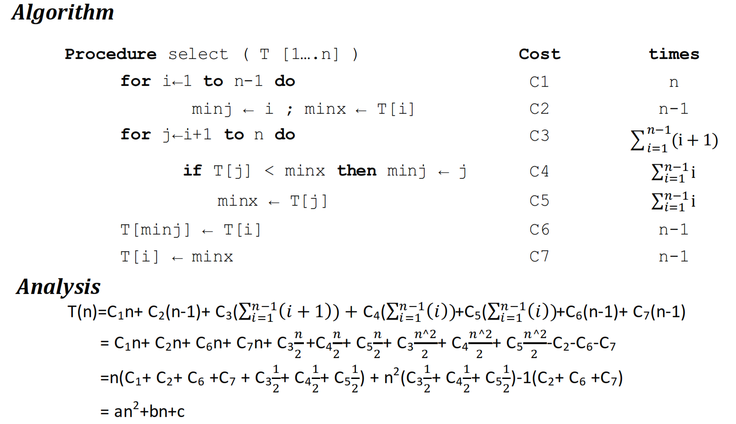
Selection Sort Analysis

Slide 41
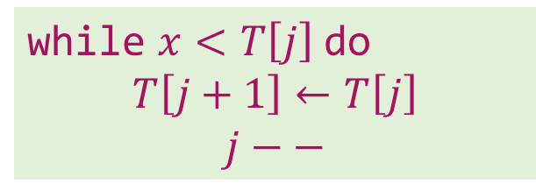



Insertion Sort – Example
Sort the following elements in Ascending order
5 | 1 | 12 | -5 | 16 | 2 | 12 | 14
Step 1 :
Unsorted Array
5 | 1 | 12 | -5 | 16 | 2 | 12 | 14
1 | 2 | 3 | 4 | 5 | 6 | 7 | 8
Step 2 :
$$j$$
$$i=2, x=1$$
$$j=i –1 and j>0$$
1
5
1
12
-5
16
2
12
14
while $x<T\left[j\right]$ do
$$T\left[j+1\right]←T\left[j\right]$$
$$j−−$$
1
2
3
4
5
6
7
8
Shift down

Slide 42

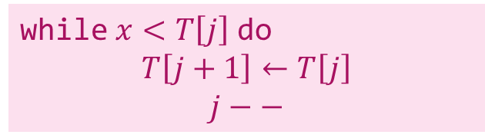


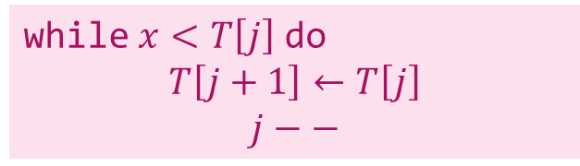




Insertion Sort – Example
Step 3 :
$$j$$
$$i=3, x=12$$
$$j=i –1 and j>0$$
1
5
12
-5
16
2
12
14
while $x<T\left[j\right]$ do
$$T\left[j+1\right]←T\left[j\right]$$
$$j−−$$
1
2
3
4
5
6
7
8
No Shift will take place
Step 4 :
$$i=4, x=−5$$
$$j=i –1 and j>0$$
$$j$$
while $x<T\left[j\right]$ do
$$T\left[j+1\right]←T\left[j\right]$$
$$j−−$$
$$j$$
-5
1
5
12
-5
16
2
12
14
1
2
3
4
5
6
7
8
Shift down
Shift down
Shift down

Slide 43







Insertion Sort – Example
Step 5 :
$$j$$
$$i=5, x=16$$
$$j=i –1 and j>0$$
-5
1
5
12
16
2
12
14
while $x<T\left[j\right]$ do
$$T\left[j+1\right]←T\left[j\right]$$
$$j−−$$
1
2
3
4
5
6
7
8
No Shift will take place
Step 6 :
$$i=6, x=2$$
$$j=i –1 and j>0$$
$$j$$
$$j$$
while $x<T\left[j\right]$ do
$$T\left[j+1\right]←T\left[j\right]$$
$$j−−$$
-5
1
2
5
12
16
2
12
14
1
2
3
4
5
6
7
8
Shift down
Shift down
Shift down

Slide 44





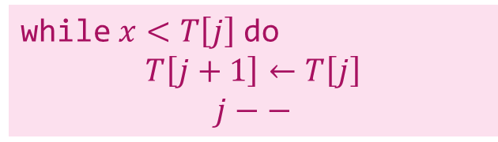

Insertion Sort – Example
Step 7 :
$$j$$
$$i=7, x=12$$
$$j=i –1 and j>0$$
-5
1
2
5
12
12
16
12
14
while $x<T\left[j\right]$ do
$$T\left[j+1\right]←T\left[j\right]$$
$$j−−$$
1
2
3
4
5
6
7
8
Shift down
Step 8 :
$$i=8, x=14$$
$$j=i –1 and j>0$$
$$j$$
while $x<T\left[j\right]$ do
$$T\left[j+1\right]←T\left[j\right]$$
$$j−−$$
-5
1
2
5
12
12
14
16
14
1
2
3
4
5
6
7
8
Shift down
The entire array is sorted now.

Slide 45


Insertion Sort - Algorithm
# Input: Array T
# Output: Sorted array T
Algorithm: Insertion_Sort(T[1,…,n])
for i ← 2 to n do
x ← T[i];
j ← i – 1;
while x < T[j] and j > 0 do
T[j+1] ← T[j];
j ← j – 1;
T[j+1] ← x;
$$θ\left(n\right)$$
$$θ\left(n^{2}\right)$$

Slide 46
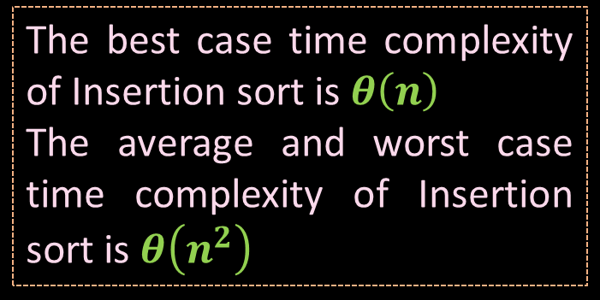

Insertion Sort Algorithm – Best Case Analysis
# Input: Array T
# Output: Sorted array T
Algorithm: Insertion_Sort(T[1,…,n])
for i ← 2 to n do
x ← T[i];
j ← i – 1;
while x < T[j] and j > 0 do
T[j+1] ← T[j];
j ← j – 1;
T[j+1] ← x;
Pass 1 :
12
23
i=2
x=23
T[j]=12
34
i=3
x=34
T[j]=23
45
i=4
x=45
T[j]=34
59
i=5
x=59
T[j]=45
$$θ\left(n\right)$$
The best case time complexity of Insertion sort is $θ\left(n\right)$
The average and worst case time complexity of Insertion sort is $θ\left(n^{2}\right)$

Slide 47
Counting Sort - Procedure
Counting sort assumes that each of the 𝑛 input elements is an integer in the range 0 to 𝑘, for some integer 𝑘.
When 𝒌=𝑶(𝒏), the counting sort runs in 𝜽(𝒏) time.
The basic idea of counting sort is to determine, for each input element 𝑥, the number of elements less than 𝑥.
This information can be used to place element 𝑥 directly into its position in the output array.

Slide 48
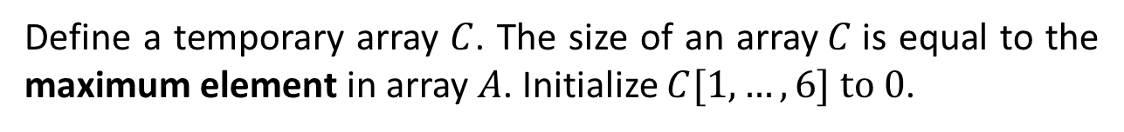
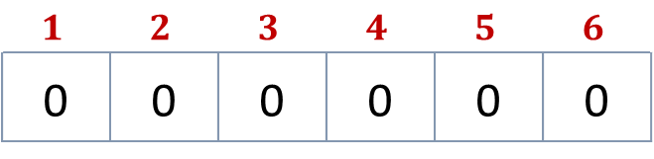
Counting Sort – Example
Sort the following elements in Ascending order using counting sort.
3 | 6 | 4 | 1 | 3 | 4 | 1 | 4 | 2
Step 1
Given elements are stored in an input array $A[1,…,9]$
Index
$$1$$ | $$2$$ | $$3$$ | $$4$$ | $$5$$ | $$6$$ | $$7$$ | $$8$$ | $$9$$
Elements
3 | 6 | 4 | 1 | 3 | 4 | 1 | 4 | 2
Step 2
Define a temporary array $C$. The size of an array$C$is equal to the maximum element in array $A$. Initialize $C[1,…,6] to 0$.
Index
$$1$$ | $$2$$ | $$3$$ | $$4$$ | $$5$$ | $$6$$
0 | 0 | 0 | 0 | 0 | 0
Elements

Slide 49

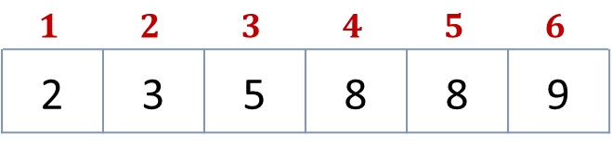
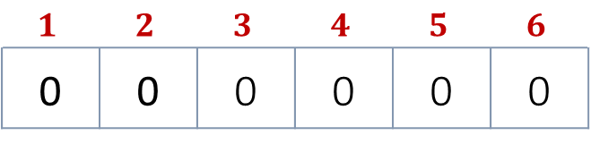
Counting Sort – Example
Sort the following elements in Ascending order using counting sort.
Input array$A$
3 | 6 | 4 | 1 | 3 | 4 | 1 | 4 | 2
Step 3
Update an array C with the occurrences of each value of array 𝐴
Index
$$1$$ | $$2$$ | $$3$$ | $$4$$ | $$5$$ | $$6$$
0 | 0 | 0 | 0 | 0 | 0
Elements
2
1
2
3
0
1
+
+
Step 4
In array 𝐶, from index 2 to 𝑛 add the value with previous element
Index
$$1$$ | $$2$$ | $$3$$ | $$4$$ | $$5$$ | $$6$$
2 | 3 | 5 | 8 | 8 | 9
Elements

Slide 50
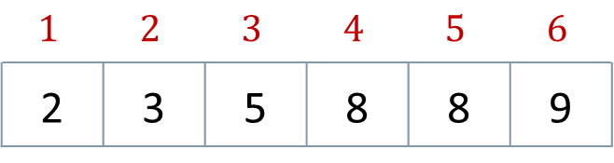
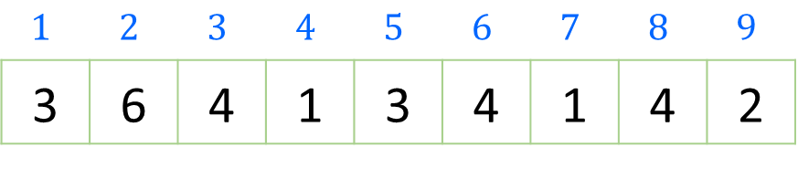

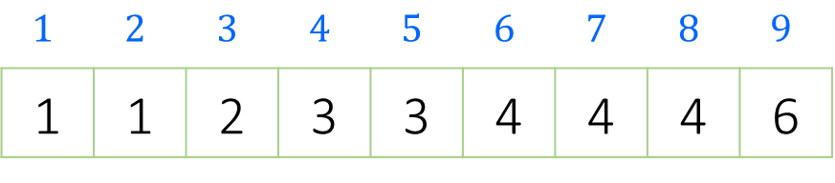
Counting Sort – Example
Create an output array 𝐵[1…9]. Start positioning elements of Array 𝐴 𝑡𝑜 𝐵 as shown below.
$$1$$ | $$2$$ | $$3$$ | $$4$$ | $$5$$ | $$6$$ | $$7$$ | $$8$$ | $$9$$
3 | 6 | 4 | 1 | 3 | 4 | 1 | 4 | 2
Input array$A$
$$1$$ | $$2$$ | $$3$$ | $$4$$ | $$5$$ | $$6$$
2 | 3 | 5 | 8 | 8 | 9
Temporary Array C
1
2
4
6
7
0
3
5
8
$$1$$ | $$2$$ | $$3$$ | $$4$$ | $$5$$ | $$6$$ | $$7$$ | $$8$$ | $$9$$
1 | 1 | 2 | 3 | 3 | 4 | 4 | 4 | 6
Output Array B

Slide 51
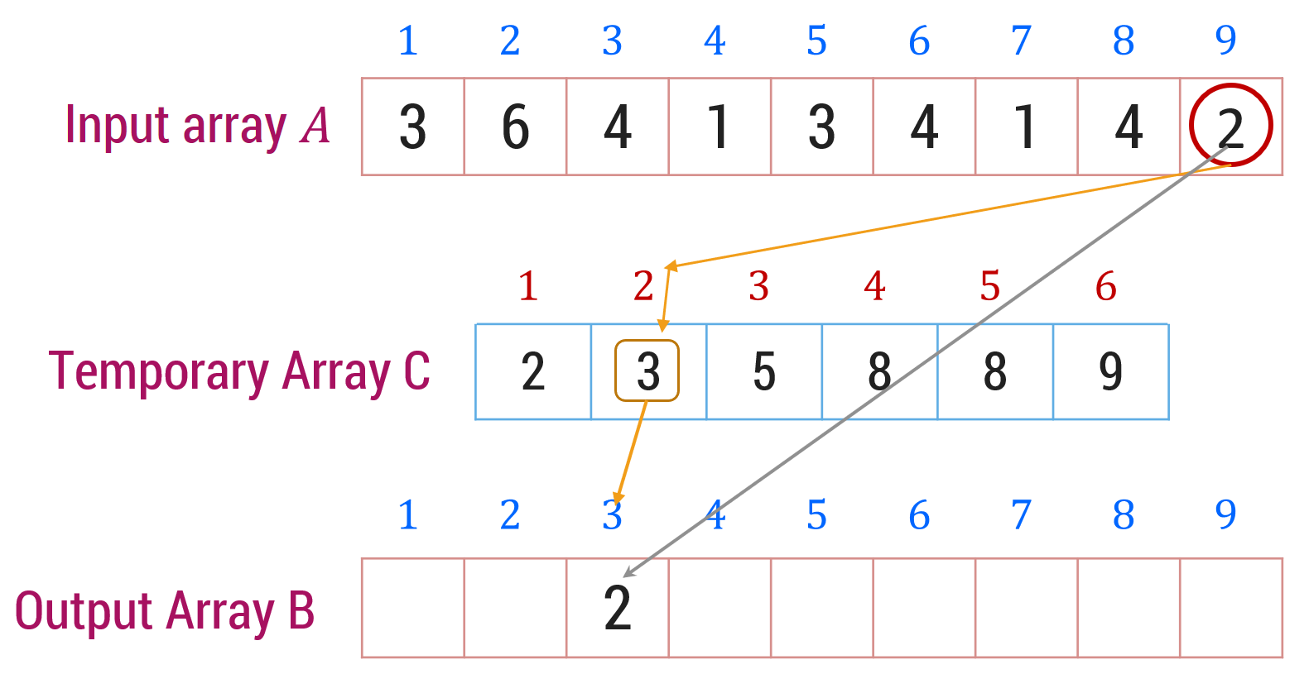
Counting Sort - Algorithm
# Input: Array A
# Output: Sorted array A
Algorithm: Counting-Sort(A[1,…,n], B[1,…,n], k)
for i ← 1 to k do
c[i] ← 0
for j ← 1 to n do
c[A[j]] ← c[A[j]] + 1
for i ← 2 to k do
c[i] ← c[i] + c[i-1]
for j ← n downto 1 do
B[c[A[j]]] ← A[j]
c[A[j]] ← c[A[j]] - 1

Slide 52
Merge sort
Merge Sort is an example of divide and conquer algorithm.
It is based on the idea of breaking down a list into several sub-lists until each sub list consists of a single element.
Merging those sub lists in a manner that results into a sorted list.
Procedure
Divide the unsorted list into N sub lists, each containing 1 element
Take adjacent pairs of two singleton lists and merge them to form a list of 2 elements. N will now convert into N/2 lists of size 2
Repeat the process till a single sorted list of all the elements is obtained

Slide 53
Merge Sort – Example
Unsorted Array
724 | 521 | 2 | 98 | 529 | 31 | 189 | 451
1 | 2 | 3 | 4 | 5 | 6 | 7 | 8
Step 1: Split the selected array
1
2
3
4
5
6
7
8
724
521
2
98
529
31
189
451
724
521
2
98
529
31
189
451
1
2
3
4
1
2
3
4

Slide 54
Merge Sort – Example
Select the left subarray and Split
Select the right subarray and Split
1
2
3
4
1
2
3
4
724
521
2
98
529
31
189
451
1
2
1
2
Split
1
2
1
2
724
521
2
98
529
31
189
451
1
1
1
1
1
1
1
1
724
521
2
98
529
31
189
451
521
724
2
98
31
529
189
451
Merge
2
98
521
724
31
189
451
529
2
31
98
189
451
521
529
724

Slide 55
Merge Sort – Algorithm
Procedure: mergesort(T[1,…,n])
if n is sufficiently small then insert(T)
else
array U[1,…,1+n/2],V[1,…,1+n/2]
U[1,…,n/2] ← T[1,…,n/2]
V[1,…,n/2] ← T[n/2+1,…,n]
mergesort(U[1,…,n/2])
mergesort(V[1,…,n/2])
merge(U, V, T)
Procedure: merge(U[1,…,m+1],V[1,…,n+1],T[1,…,m+n])
i ← 1;
j ← 1;
U[m+1], V[n+1] ← ∞;
for k ← 1 to m + n do
if U[i] < V[j]
then T[k] ← U[i];
i ← i + 1;
else T[k] ← V[j];
j ← j + 1;

Slide 56
step 1: start
step 2: declare array and left, right, mid variable
step 3: perform merge function. if left > right return mid= (left+right)/2 mergesort(array, left, mid) mergesort(array, mid+1, right) merge(array, left, mid, right)
step 4: Stop

Slide 57
... merge(int[] a, int i, int mid, int j) {
// Merges the 2 sorted sub-arrays a[i..mid] and
// a[mid+1..j] into one sorted sub-array a[i..j]
int[] temp = new int[j-i+1]; // temp storage
int left = i, right = mid+1, it = 0;
// it = next index to store merged item in temp[]
// Q: What are left and right?
while (left<=mid && right<=j) { // output the smaller
if (a[left] <= a[right])
temp[it++] = a[left++];
else
temp[it++] = a[right++];
}

Slide 58
// Copy the remaining elements into temp.
while (left<=mid) temp[it++] = a[left++];
while (right<=j) temp[it++] = a[right++];
// Copy the result in temp back into
// the original array a
for (int k = 0; k < temp.length; k++)
a[i+k] = temp[k];
}

Slide 59
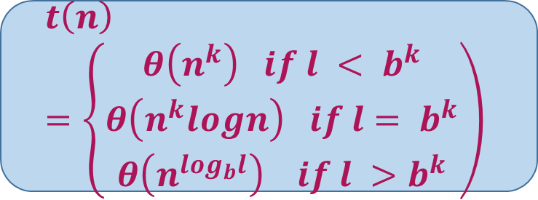
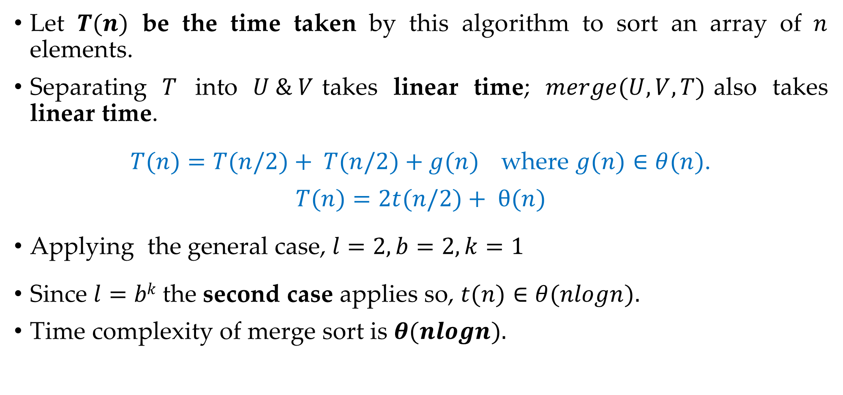

Merge Sort - Analysis
Let $T(n)$ be the time taken by this algorithm to sort an array of $n$ elements.
Separating $T$ into $U \& V$takes linear time; $merge(U, V, T)$also takes linear time.
$T(n)=T(n/2)+ T(n/2)+g(n)$where $g(n)∈θ(n)$.
$$T(n)=2t(n/2)+ θ(n)$$
Applying the general case, $l=2, b=2, k=1$
Since $l=bk$the second case applies so, $t(n)∈θ(nlogn).$
Time complexity of merge sort is $θ(nlogn).$
$$t\left(n\right)=lt\left(n/b\right)+g\left(n\right)$$
$$t\left(n\right)=\left\{\begin{aligned}θ\left(n^{k}\right) if l < b^{k} \\ θ\left(n^{k}logn\right) if l= b^{k} \\ θ\left(n^{\log_{b}l}\right) if l >b^{k}\end{aligned}\right)$$

Slide 60
Quick sort
Quick sort chooses the first element as a pivot element, a lower bound is the first index and an upper bound is the last index.
The array is then partitioned on either side of the pivot.
Elements are moved so that, those greater than the pivot are shifted to its right whereas the others are shifted to its left.
Each Partition is internally sorted recursively.
Pivot
Element
0
1
2
3
4
5
6
7
8
9
42
23
74
11
65
58
94
36
99
87
LB
UB

Slide 61
Quick Sort - Example
Procedure pivot(T[i,…,j]; var l)
p ← T[i]
k ← i; l ← j+1
Repeat
k ← k+1 until T[k] > p or k ≥ j
Repeat
l ← l-1 until T[l] ≤ p
While k < l do
Swap T[k] and T[l]
Repeat k ← k+1 until
T[k] > p
Repeat l ← l-1 until
T[l] ≤ p
Swap T[i] and T[l]
0
1
2
3
4
5
6
7
8
9
42
23
74
11
65
58
94
36
99
87
k
l
Swap
42
23
74
36
11
65
58
94
36
74
99
87
k
l
Swap
11
42
23
36
11
42
65
58
94
74
99
87
k
l
LB = 0, UB = 9
p = 42
k = 0, l = 10

Slide 62
Quick Sort - Example
Procedure pivot(T[i,…,j]; var l)
p ← T[i]
k ← i; l ← j+1
Repeat
k ← k+1 until T[k] > p or k ≥ j
Repeat
l ← l-1 until T[l] ≤ p
While k < l do
Swap T[k] and T[l]
Repeat k ← k+1 until
T[k] > p
Repeat l ← l-1 until
T[l] ≤ p
Swap T[i] and T[l]
0
1
2
3
4
5
6
7
8
9
11
23
36
42
65
58
94
74
99
87
LB
UB
11
23
36
11
k
l
LB
UB
11
23
36
42
65
58
94
74
99
87
23
36
23
k
l
11
23
36
42
65
58
94
74
99
87

Slide 63
Quick Sort - Example
LB
UB
Procedure pivot(T[i,…,j]; var l)
p ← T[i]
k ← i; l ← j+1
Repeat
k ← k+1 until T[k] > p or k ≥ j
Repeat
l ← l-1 until T[l] ≤ p
While k < l do
Swap T[k] and T[l]
Repeat k ← k+1 until
T[k] > p
Repeat l ← l-1 until
T[l] ≤ p
Swap T[i] and T[l]
0
1
2
3
4
5
6
7
8
9
11
23
36
42
65
58
94
74
99
87
Swap
65
65
58
94
74
99
87
58
65
k
l
58
65
94
74
99
87
LB
UB
11
23
36
42
58
65
94
74
99
87

Slide 64
Quick Sort - Example
LB
UB
Procedure pivot(T[i,…,j]; var l)
p ← T[i]
k ← i; l ← j+1
Repeat
k ← k+1 until T[k] > p or k ≥ j
Repeat
l ← l-1 until T[l] ≤ p
While k < l do
Swap T[k] and T[l]
Repeat k ← k+1 until
T[k] > p
Repeat l ← l-1 until
T[l] ≤ p
Swap T[i] and T[l]
Swap
94
94
74
99
87
87
99
k
l
Swap
87
94
94
74
87
99
k
l
LB
UB
Swap
74
87
87
74
94
99
87
k
l
11
23
36
42
58
65
74
87
94
99

Slide 65
Quick Sort - Algorithm
Procedure: quicksort(T[i,…,j])
{Sorts subarray T[i,…,j] into ascending order}
if j – i is sufficiently small then insert (T[i,…,j])
else
pivot(T[i,…,j],l)
quicksort(T[i,…,l - 1])
quicksort(T[l+1,…,j]
Procedure: pivot(T[i,…,j]; var l)
p ← T[i]
k ← i
l ← j + 1
repeat k ← k+1 until T[k] > p or k ≥ j
repeat l ← l-1 until T[l] ≤ p
while k < l do
Swap T[k] and T[l]
Repeat k ← k+1 until T[k] > p
Repeat l ← l-1 until T[l] ≤ p
Swap T[i] and T[l]

Slide 66
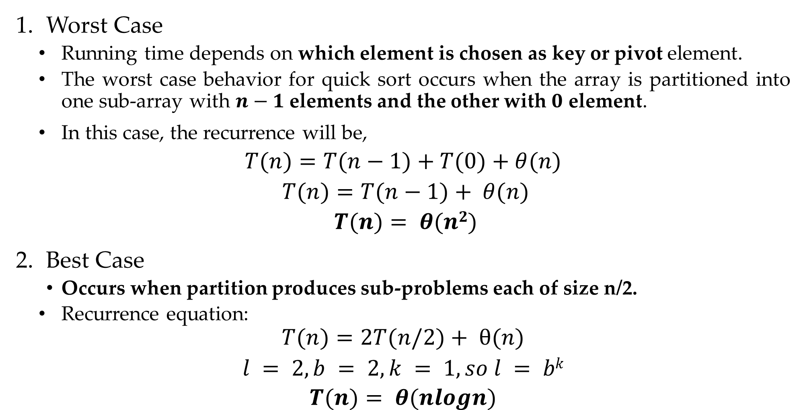
Quick Sort Algorithm – Analysis
Worst Case
Running time depends on which element is chosen as key or pivot element.
The worst case behavior for quick sort occurs when the array is partitioned into one sub-array with $n−1$ elements and the other with $0$ element.
In this case, the recurrence will be,
$$T(n)=T(n−1)+T(0)+θ(n)$$
$$T(n)=T(n−1)+ θ(n)$$
$$T(n)= θ(n2)$$
Best Case
Occurs when partition produces sub-problems each of size n/2.
Recurrence equation:
$$T(n)=2T(n/2)+ θ(n)$$
$$l = 2, b = 2, k = 1, so l = bk$$
$$T(n)= θ(nlogn)$$

Slide 67

Quick Sort Algorithm – Analysis
Average Case
Average case running time is much closer to the best case.
If suppose the partitioning algorithm produces a 9:1 proportional split the recurrence will be,
$$T(n)=T(9n/10)+ T(n/10)+ θ(n)$$
$$T(n)= θ(nlogn)$$

